Slide 1
Agile Development
Jacob Virgilio

Slide 2
Agile Roles
Product Owner
Works closely with client
Helps translate client wants/needs to development team
SCRUM Master
Regulates the agile principles
Leader of SCRUM meetings
Facilitates SCRUM events
Developer
Main workhorse of the project
Takes input from clients and shareholders
Creates product
Tester
Helps developer fix problems in program
Detail oriented

Slide 3
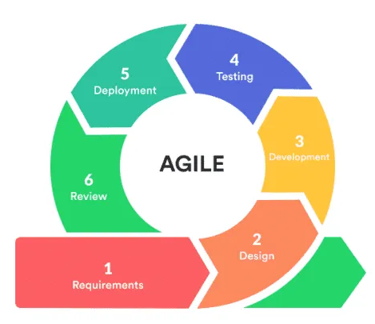
Agile Development Lifecycle
Requirements
Collect required materials
Collaborate with customers
Design
Delegate process for functionality
Define limitations
Development
Product creation begins
Broken up into smaller parts for development
Testing
Product is tested for usage
Occurs during development
Deployment
Product released to market
Review
Product is in market, and being review
Failures/successes are used to further next project.

Slide 4
Agile
Waterfall
Flexible requirements
Functionality can evolve over time
More likely to leak over budget
All requirements defined
Inflexible stages
Budget unchangeable.

Slide 5
Sources
What is Agile Project Management? A Comprehensive 101 Guide. (n.d.). https://slite.com/learn/agile

